Slide 1
NOWL Neighborhood Plan Loop Corridor Focus Group August 15, 2016

Slide 2
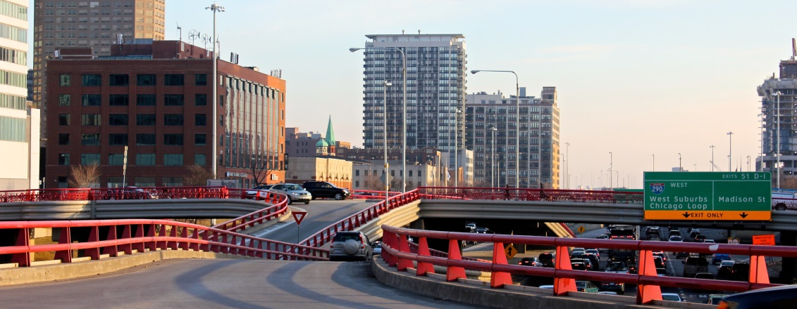
Meeting Goals
Introduce Neighbors of West Loop (NOWL) and the NOWL Neighborhood Plan
Provide background
Gather your input and participation

Slide 3
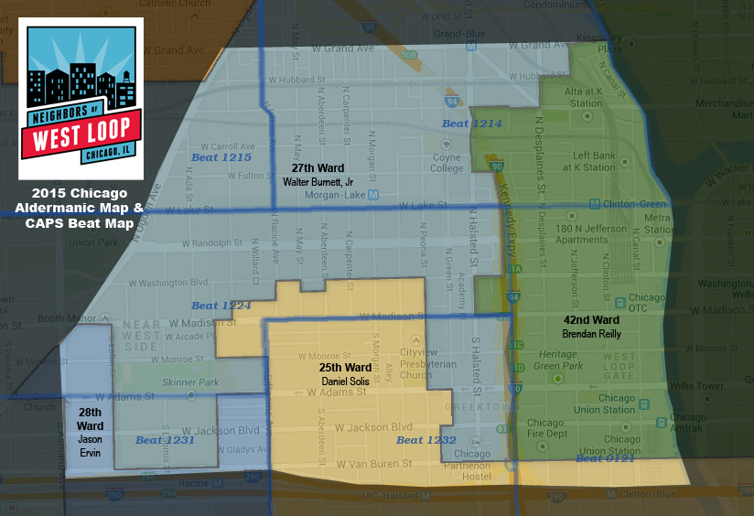
Neighbors of West Loop
Mission & goals
501(c)(3)
All volunteer
Resident-focused
Notes:
All volunteer – no outside funding, emphasis on community input and transparency.

Slide 4
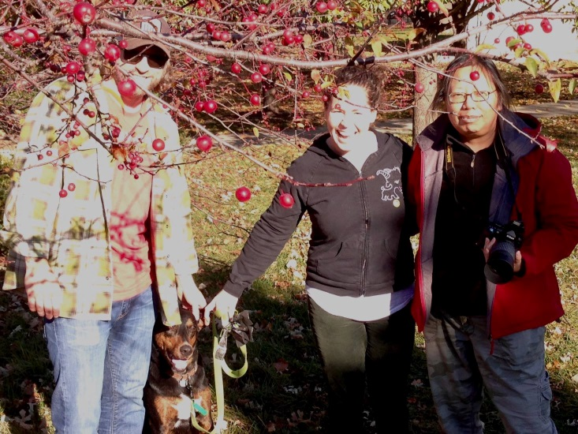
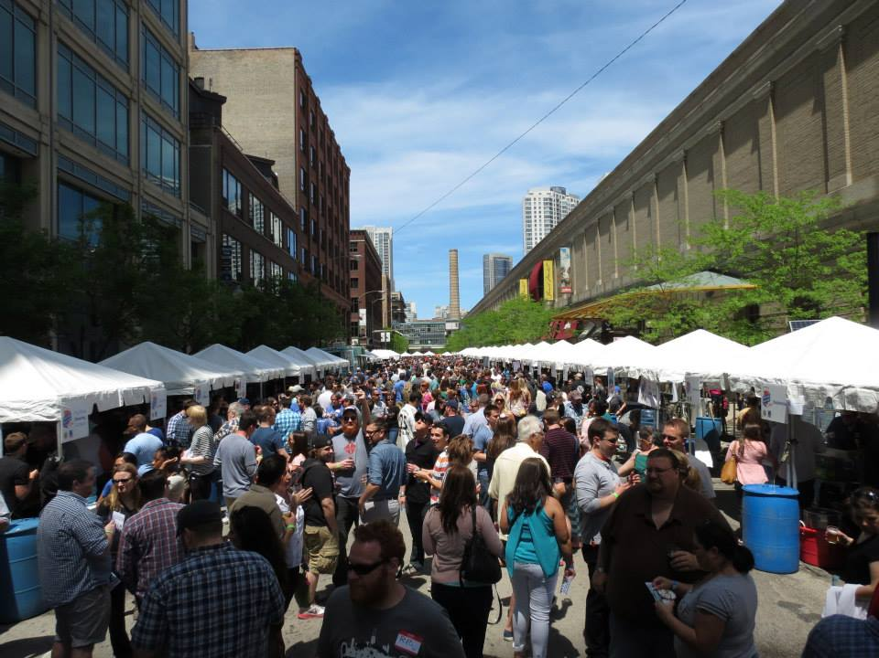
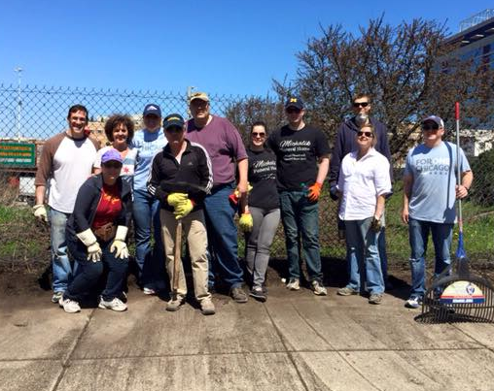
Neighbors of West Loop
Giving stronger voice to residents
Philanthropy and park beautification projects
Hosting local events, e.g., West Loop Craft Beer Fest
Keeping the community informed

Slide 5
Neighbors of West Loop Mission and Vision Statements
The Mission of Neighbors of West Loop:
To enhance the quality of life for residents and neighbors of Chicago’s greater West Loop Community. We engage those who want to participate in positive collaboration for improving our vibrant neighborhoods
The Vision of Neighbors of West Loop:
To be the “NOWL Neighborhood Plan”
Purpose: to articulate the concerns and desires of the West Loop community regarding preservation/enhancement of the features and attributes of the West Loop that have attracted interest from investors/developers of residential projects and commercial enterprises as well as interest from individuals seeking the urban life-style as residents
TBD

Slide 6
Neighborhood Plan Background

Slide 7
Review of Prior Studies
Central West Redevelopment Plan (1969)
Madison-Racine Redevelopment Plan (1979)
West Loop Adaptive Reuse Analysis (1983)
West Loop Task Force Report (1985)
Near West (1994) and Central West (1999) Redevelopment Project Area TIF Program

Slide 8
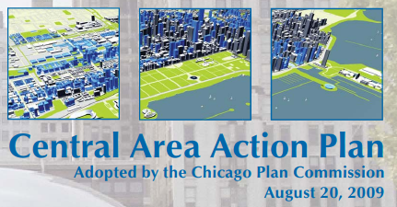
Review of Prior Studies
Near West Side Area Land Use Plan (2000)
Central Area Action Plan (2009)

Slide 9
Near West Side Plan
Promote “low to moderate density” residential development
Create “strategically located off-street, shared parking”
Neighborhood-oriented retail
Discourage uses that conflict with pedestrian activity
Notes:
Projected 2020 population of 15,300 (actual of 22,500 as of 2012)
Realign Madison/Racine intersection
“to activate the area and create a more recognized neighborhood identity”

Slide 10
Near West Side Plan
“Do not maximize the number of permitted units under existing zoning”
“Planned development should not be used to up-zone sites”
New development should retain the scale of the “existing building fabric”
Family-sized units are encouraged
Notes:
Projected 2020 population of 15,300 (actual of 22,500 as of 2012)
Realign Madison/Racine intersection
“to activate the area and create a more recognized neighborhood identity”
“New buildings should not be more than 25% higher than the average height of buildings on surrounding blocks to maintain the general scale of an urban industrial loft district, except on the properties abutting the Kennedy Expressway.”

Slide 11
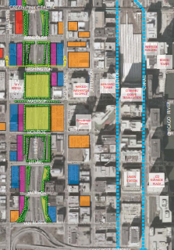
Central Area Plan
Step down density from the expressways (higher along Halsted and Van Buren)
Medium density along Madison
Pedestrian mobility enhancements

Slide 12
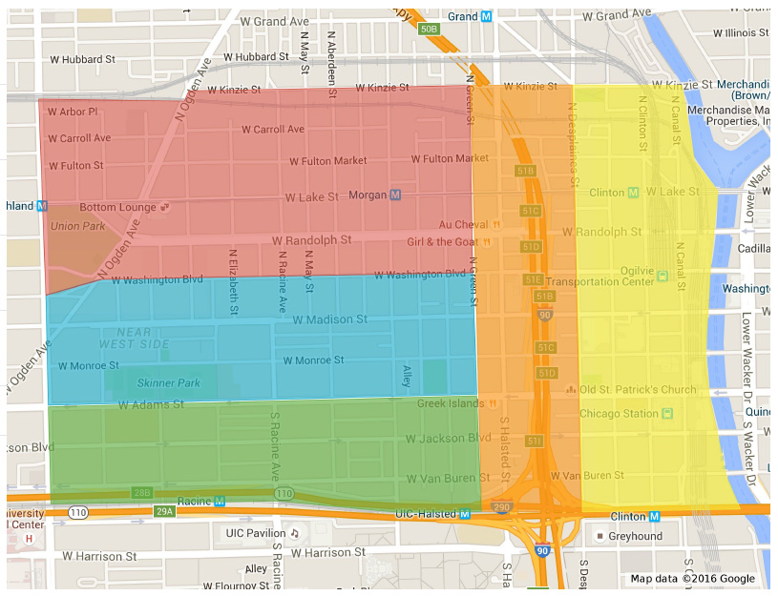
NOWL Neighborhood Plan
Five study corridors:
Jackson
Madison
Fulton Market
Halsted/Kennedy
Loop
Notes:
Corridors chosen based on use, trends, location. Discussion leaders identified for each corridor (introduce).

Slide 13
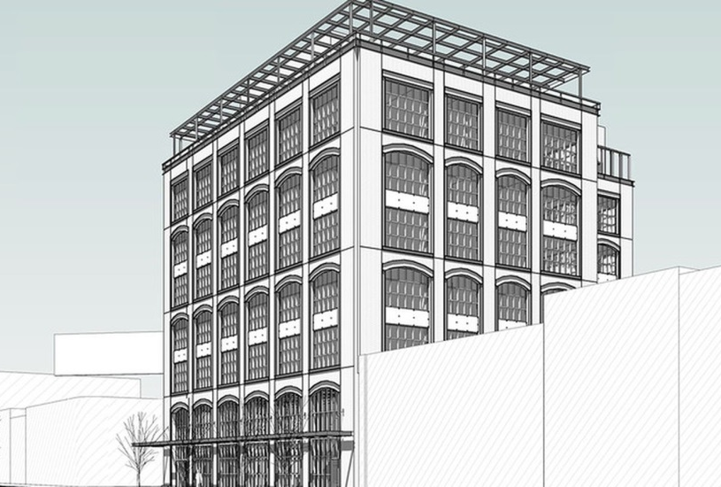
NOWL Neighborhood Plan
Small group discussions for each corridor
Identify development categories
Compile findings
Report
Maps
Apply toward future developments
Review annually

Slide 14
Group Discussion

Slide 15
Discussion Topics
Development guidelines
Traffic
Parking
Schools
Community facilities
Parks/green space
Streetscaping
Infrastructure
Public safety
Other

Slide 16
Discussion Approach
Describe current state
Describe desired state
Responsibility
Rankings

Slide 17
Discussion Group Template
Corridor Name: _____________
 | Describe Current State (Satisfactory/ Unsatisfactory) | Describe Desired State (Needed Enhancements) | Responsibility (City, Developer, Owner/Leasor, etc.) | Rank 1-10 (not rate) Importance (most important = 1)
Development guidelines - height/density - set-back requirements - material requirements - architectural aspects
Traffic - flow/congestion - traffic control - dangerous intersections - alley usage/ROW

Slide 18
Discussion Group Template
Corridor Name: _____________
 | Describe Current State (Satisfactory/ Unsatisfactory) | Describe Desired State (Needed Enhancements) | Responsibility (City, Developer, Owner/Leasor, etc.) | Rank 1-10 (not rate) Importance (most important = 1)
Parking - residents - visitors (e.g. customers, guests, patrons) employees
Schools
Community Facilities - libraries - park fieldhouses - community center

Slide 19
Discussion Group Template
Corridor Name: _____________
 | Describe Current State (Satisfactory/ Unsatisfactory) | Describe Desired State (Needed Enhancements) | Responsibility (City, Developer, Owner/Leasor, etc.) | Rank 1-10 (not rate) Importance (most important = 1)
Parks/Green Space - private public
Streetscaping - lighting - sidewalk furniture - trees/plants

Slide 20
Discussion Group Template
Corridor Name: _____________
 | Describe Current State (Satisfactory/ Unsatisfactory) | Describe Desired State (Needed Enhancements) | Responsibility (City, Developer, Owner/Leasor, etc.) | Rank 1-10 (not rate) Importance (most important = 1)
Infrastructure - pavement/sidewalk condition - trash cans/dumpster locations
Public Safety - crime noise
Other please specify

Slide 21
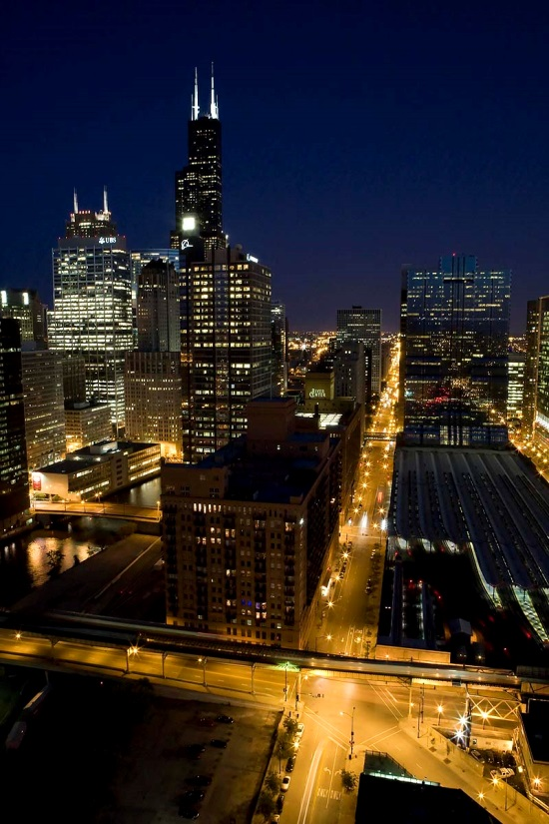
Next Steps
Second focus group discussions
Presentation of findings
NOWL Neighborhood Plan review
To be distributed to NOWL members
Plan presentation
Aldermanic meetings, community meeting

Slide 22
Neighbors of West Loop
Membership
Support our efforts!
Get exclusive neighborhood updates
Join a committee
Receive discounts
And more!
Sponsorship opportunities for businesses
Membership Type | Cost (Annual)
Household (up to 4 individuals) | $35
Resident association 10 or less units 11-100 units 101 or more units | $150 $300 $750
Notes:
We need your support to sustain our efforts! Mention to your condo board/manager. Discounts on NOWL events, hope to have local business discounts soon.

Slide 23
Discussion Group Background Demographics
Corridor Name: _____________
How many years have you lived in the West Loop? | 0-1 year | 1 – 3 years | 3-5 years | >5 years
How many years do you expect to live in the West Loop? | 0-1 year | 1 – 3 years | 3-5 years | >5 years
Number of individuals in your household | 1 | 2 | 3-5 | >5
Age of eldest individual in your household | <25 | 25-35 | 35-50 | >50
Household Income | <35k | 35-49k | 50-75k | >75k
Highest Level of Education | High School | Some College | Associate or Bachelor Degree | Graduate or Post-Graduate School
Describe where you live | Apartment | Condo | Townhome | Single Family Home

Slide 24
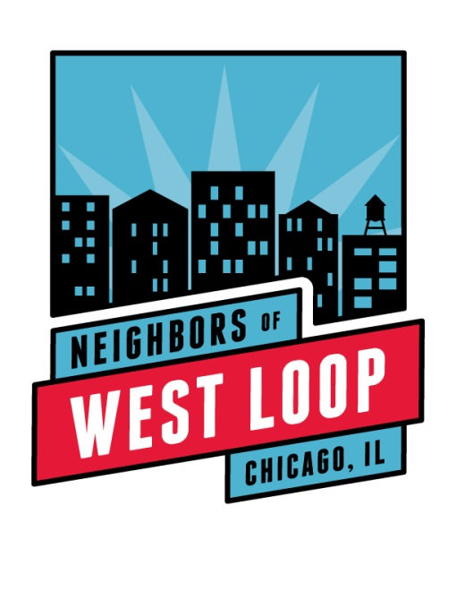
Thank you for your participation!
www.neighborsofwestloop.com
www.facebook.com/neighborsofwestloop
@neighborsWLoop
Notes:
Like our Facebook page & follow us on Twitter!

Slide 25
Discussion Group Starter Questions
Corridor Name: _____________
What do you like about Chicago?
What are the biggest challenges facing Chicago?
Why do you like about the West Loop?
What are the biggest challenges facing the West Loop?
What will change about the West Loop over the next 3 – 5 years?

Slide 26
Issues - Force Ranking and Deconstruct
Corridor Name: _____________
How do the following issues affect you?
Development guidelines
Traffic
Parking
Schools
Community Facilities – Libraries
Parks/Green Space
Streetscaping
Infrastructure
Public Safety
Other - Issues mentioned in earlier discussion
Rank these issues based on importance to you
Prioritize which issue you would like to “fix” first
How would you like the issue “fixed”

